Slide 1




welcome
Notes:
This slide is up whilst people are arriving and music is playing.
When you start welcome everyone and ask them to switch off their mobile phones or switch them to silent if they need to leave them on for any reason
Advise of any housekeeping issues like where the toilets are, etc
Move to next slide immediately after this

Slide 2


Business Success Training
Module 1
Notes:
Announce that this is Module 1 of the Reliv Business Success Training program which will last for approx. 2 hours with a 10 minute break in the middle
Say what I'm going to do today share with you some of the foundational success steps that distributors have used to build successful Reliv businesses.
Congratulate everyone for being there, on making the decision to join Reliv (if new people in the room), and investing in your business today.
Share the Reliv story – to ensure everyone knows it and has the confidence to share it by regularly hearing it, in a nutshell (this can be as short or detailed as we determine):
Reputable company been in business for 27 years.
Founded on a product and a mission to nourish our world
Creator spent 10 years researching and developing the first nutritional formula, still the basis for our number one selling product today.
Retired businessman Bob Montgomery met Dr Kalogris at a health show, he was interested in the science behind the formula – potency, synergy, bioavailability - and he and his family had great health results from the product.
Dr Kalogris was a scientist he didn’t know how to market the product and after his own great results Bob Montgomery knew this was something special.
Bob understood the power of personal recommendation and decided the best way to market this product was through Direct Selling, which also gave people who may not have the money to start a business or franchise, the opportunity to start their own Direct Selling business for a very low start-up and unlimited income potential.
Renowned food scientist Dr Carl Hastings joined forces and Reliv was born.
Today we are fulfilling the mission of nourishing our world by helping people with their health, their finances and we are currently feeding over 40,000 people daily, mostly children, through our charity, the Reliv Kalogris Foundation.
This is a company to be proud of, a company with nutritional products and a business opportunity you need to share with everyone you know and today we’ll teach you how.
Move to next slide

Slide 3
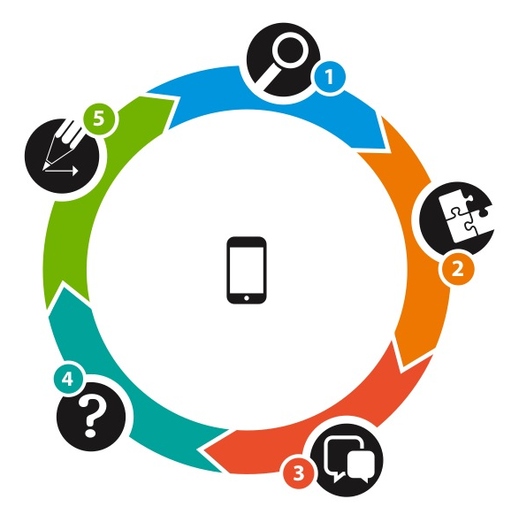



Q: How do you succeed with Reliv?
CIRCLE OF SUCCESS
Fundamental Steps
RELIV SYSTEM
Business Cycle
NEW PEOPLE
Daily
Activity
Corporate
Support
A: Fuel your business with new people!
Notes:
SAY - When people first start this business their first question is how do I succeed with relive there are five fundamental actions that you need to do consistently everyday as part of the circle of success.
The five actions are:
1. Identifying
2. Connect
3. Share the story
4. Ask for a decision
5. Register and go
As new people come into your business you plug them into the reliv success system
It's all about fuelling your business with new people

Slide 4


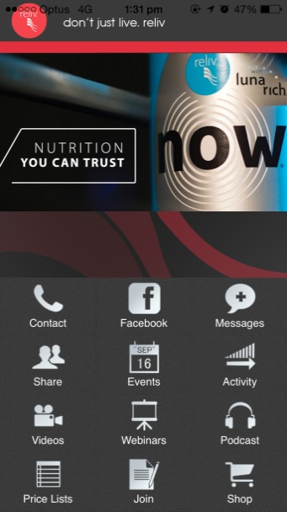
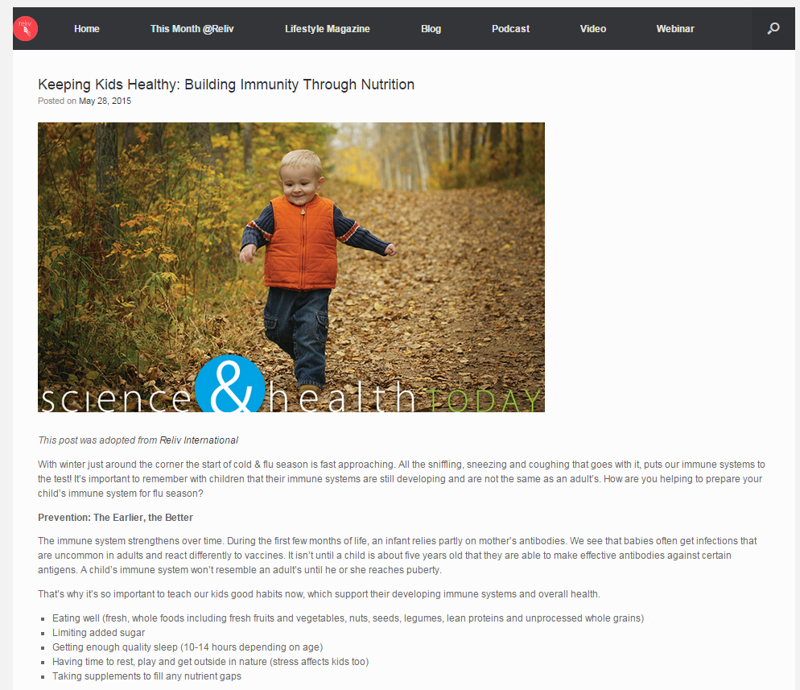



Reliv Tools
reliv.com/getstarted
Notes:
Relive provides excellent sales tools to assist you in building your business
Here are a number of them here they include product catalogues lifestyle magazine corporate videos opportunity booklet opportunity presentation RAP training website and of course one of the most useful is the reliv Asia-Pacific mobile app
Make yourself familiar with all of these tools and used them in building your business and remember the relive mobile app has all the tools you require in the palm of your hand a matter where you are

Slide 5
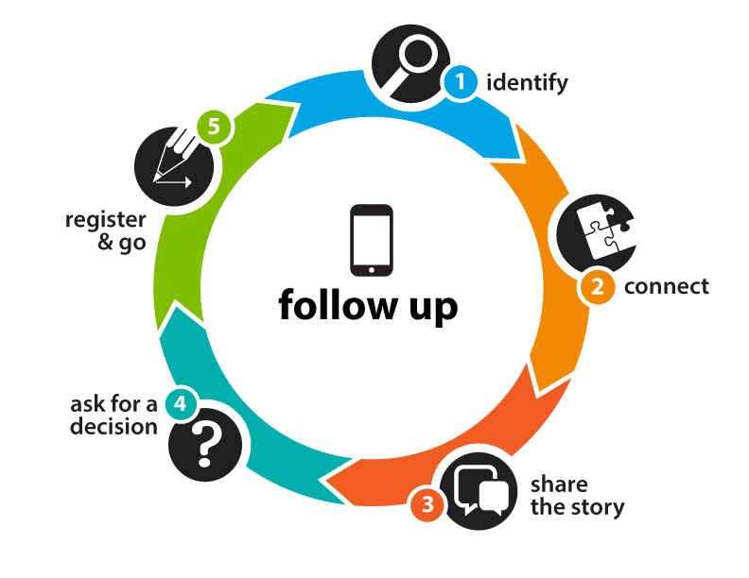

Circle of Success
Key: Action NOW!
These are the daily fundamentals.
Notes:
In two days training session we are going to look at the first two parts of the circle of success identify and connect and the key is action now!

Slide 6

Circle of Success
Identify
Connect
Share the Story
Ask for a Decision
Register & Go
Notes:
We will go through identify and connect today and the rest in following success training modules

Slide 7
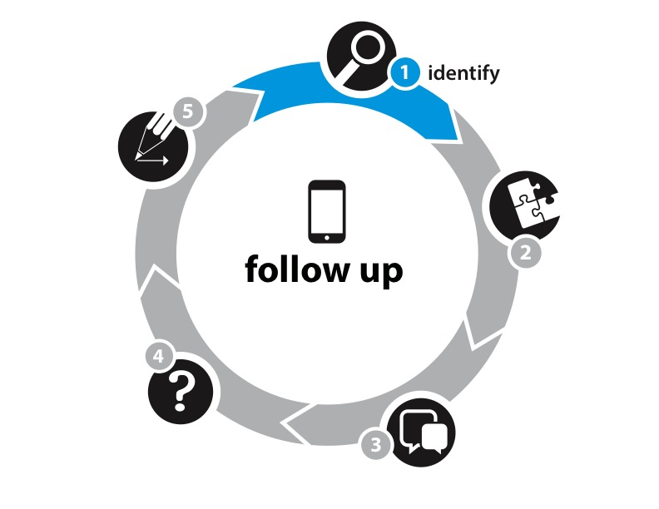
1. Identify
Who do you want on your team?
Hot Market
  Centre of Influence
  Who do you know?
Warm Market
  Who do your people know?
  People you come into contact with when out and about
Cold Market
  People you don’t know Who can we connect with right now?
Notes:
“All business growth begins with a lengthy list of people to contact. Who should be on your list? Pretty much every single person you know if you want to be successful!”
“The list starts, of course, with your hot market – people you know. Think of people who could be a centre of influence. These are people who know lots of other people, it may be true their job or community or church or whatever but these people are normally very social and have very large networks these are really good people to have onside and if they see the opportunity they think board but even if they don't is you can have them as a preferred customer and get many referrals from them
Then there’s your warm market – referrals, friends of friends, people you meet when you’re out and about. The significance of your warm market is that you have some level of credibility with these people because they know you through an associate or a business situation or a community group or whatever. The key factor here is that's that firsts barrier does not exist because of that third party connection
And finally your cold market – people you’d like to know. You might meet these people through advertising, markets, etc.” Cold market obviously people that you don't not is the hardest market to penetrate. It is important to work both your hot market in your warm market as hard as you can and as extensively as you can before you start on your cold market. If you master the art of referrals you can continue to have a warm market to work with for a significant length of time and potentially forever
“The critical point here is not to pre-judge. We all have a tendency to think: ‘Oh, they’re too successful, beautiful, busy, fill in the blank, to want to do this.’ You must allow people the common courtesy of deciding for themselves if Relìv might be something they’re interested in pursuing.” [You may wish to give a personal example here.]
“Your contact list becomes a living, changing document that you will use forever and it starts the moment you sign up”

Slide 8


Identify
Make a list now:
10 product prospects
10 business prospects
Write why you thought of each:
  Provides purpose for first contact and follow-up
Who are the first 5 to contact?
Who TODAY?
Work with your upline to develop this list
Notes:
So it's time to make your list this should be a minimum of 20 people to begin with. You should also create a possibilities list it up to 200 names on it of every single person you can think of that you come into contact with on a daily basis and add to this list consistently every day as you meet new people.
Depending on your sponsor and the way they do the business some people like to break it down into prospects interested in product or opportunity. Therefore, the first question is who you want to talk to about reliv. Who are the people who are interested in the opportunity and people who are interested in the products. Introduce both sides of the business - product and opportunity to people don't prejudge As we have already spoken about.
Make a list of names and right next to each name why you wrote their name on the list because this is very important to you as you take the next step of connection because you're going to tell them this is why I thought of you.
As you are building that list of people identify who are the first five people you want to talk to because those five are the first ones you're going to introduce to reliv. Create a living list so that as you are out and about each day meeting people and doing things you just continually add people to that list and let people know about reliv.
As you sit with your sponsor and build your list important to know who are those five people you going to speak to today and your sponsor should do talking and start the calls for you this is so that they teach you what to do and it duplicates the action as you learn then you can do the same thing as you sponsor new distributors into your business.

Slide 9
Identify
Always have new people to talk to
Create a Possibilities List
    200 people
    Means you never run out of prospects
    When a prospect drops out you simply select another from the Possibilities List
Family, friends, work, church, school, social media…
People you come into contact anytime, anywhere
Find ways to add to your list every day
Add people to your list every day
Notes:
ACTIVITY: Give participants 3 minutes to write down as many contact names as possible from as many different areas of their life as possible. (You might reward the person who lists the most with a Business Tool.)
Ask for volunteers to share 3 areas of their life to which the names belong. (For example: friends, family, work, softball league, church, etc.) Once a volunteer says the category, it can’t be repeated. Chart responses on flipchart/ whiteboard. Your goal is to get lots of different categories on the board to open their eyes – you want to make the point that they do know a lot of people!
As I said before you create a possibilities list 200 people because this means that you never run out of prospects you simply select another person from possibilities list each time I prospect drops off your active list you need to look at all the different places where you can come into contact with people and remember it is anytime anywhere in any activity at any time of day.

Slide 10
Identify
Your list is never complete
It will evolve with you as a Distributor
Add to you List everyday
Don’t pre-judge
Everyone deserves the chance to choose
What aspect of Reliv is right for them
Use memory joggers from your Getting Started Guide
Add people to your list every day
Notes:
Really is important that you understand that you list is never complete it will evolve with you not just as a distributor but as a person as you grow in confidence and your skill levels grow. By adding to the list every day and not prejudging people who are giving yourself a much better chance of striking the diamonds that are out there and are interested in the business.
As it says here everyone deserves a chance to choose and it's what aspect of relive is right for them at the time I remember timing is a big part in people's lives how busy they are, what's happening work, what's happening in their family life, and of course what are they willing to do and how much desire do they have to improve the life.
Getting started guide is a great tool to use and you should be using it yourself and also the very first thing you should do with any new person is get them to go through this with you as you build their list and of course you're doing the same thing when you're building your list.
The key factor though as always is to add people to your list every day. Success is about doing the little things consistently every day that need to be done not when you feel like it when you think you have enough energy or when you're filling happy but every single day no matter where you are how you feel when you happy with your sad when you feel like you have a lot of energy regardless of any of that it is about doing little things consistently everyday and this is one of the things that separates successful people from people who never achieve the success they desire.

Slide 11
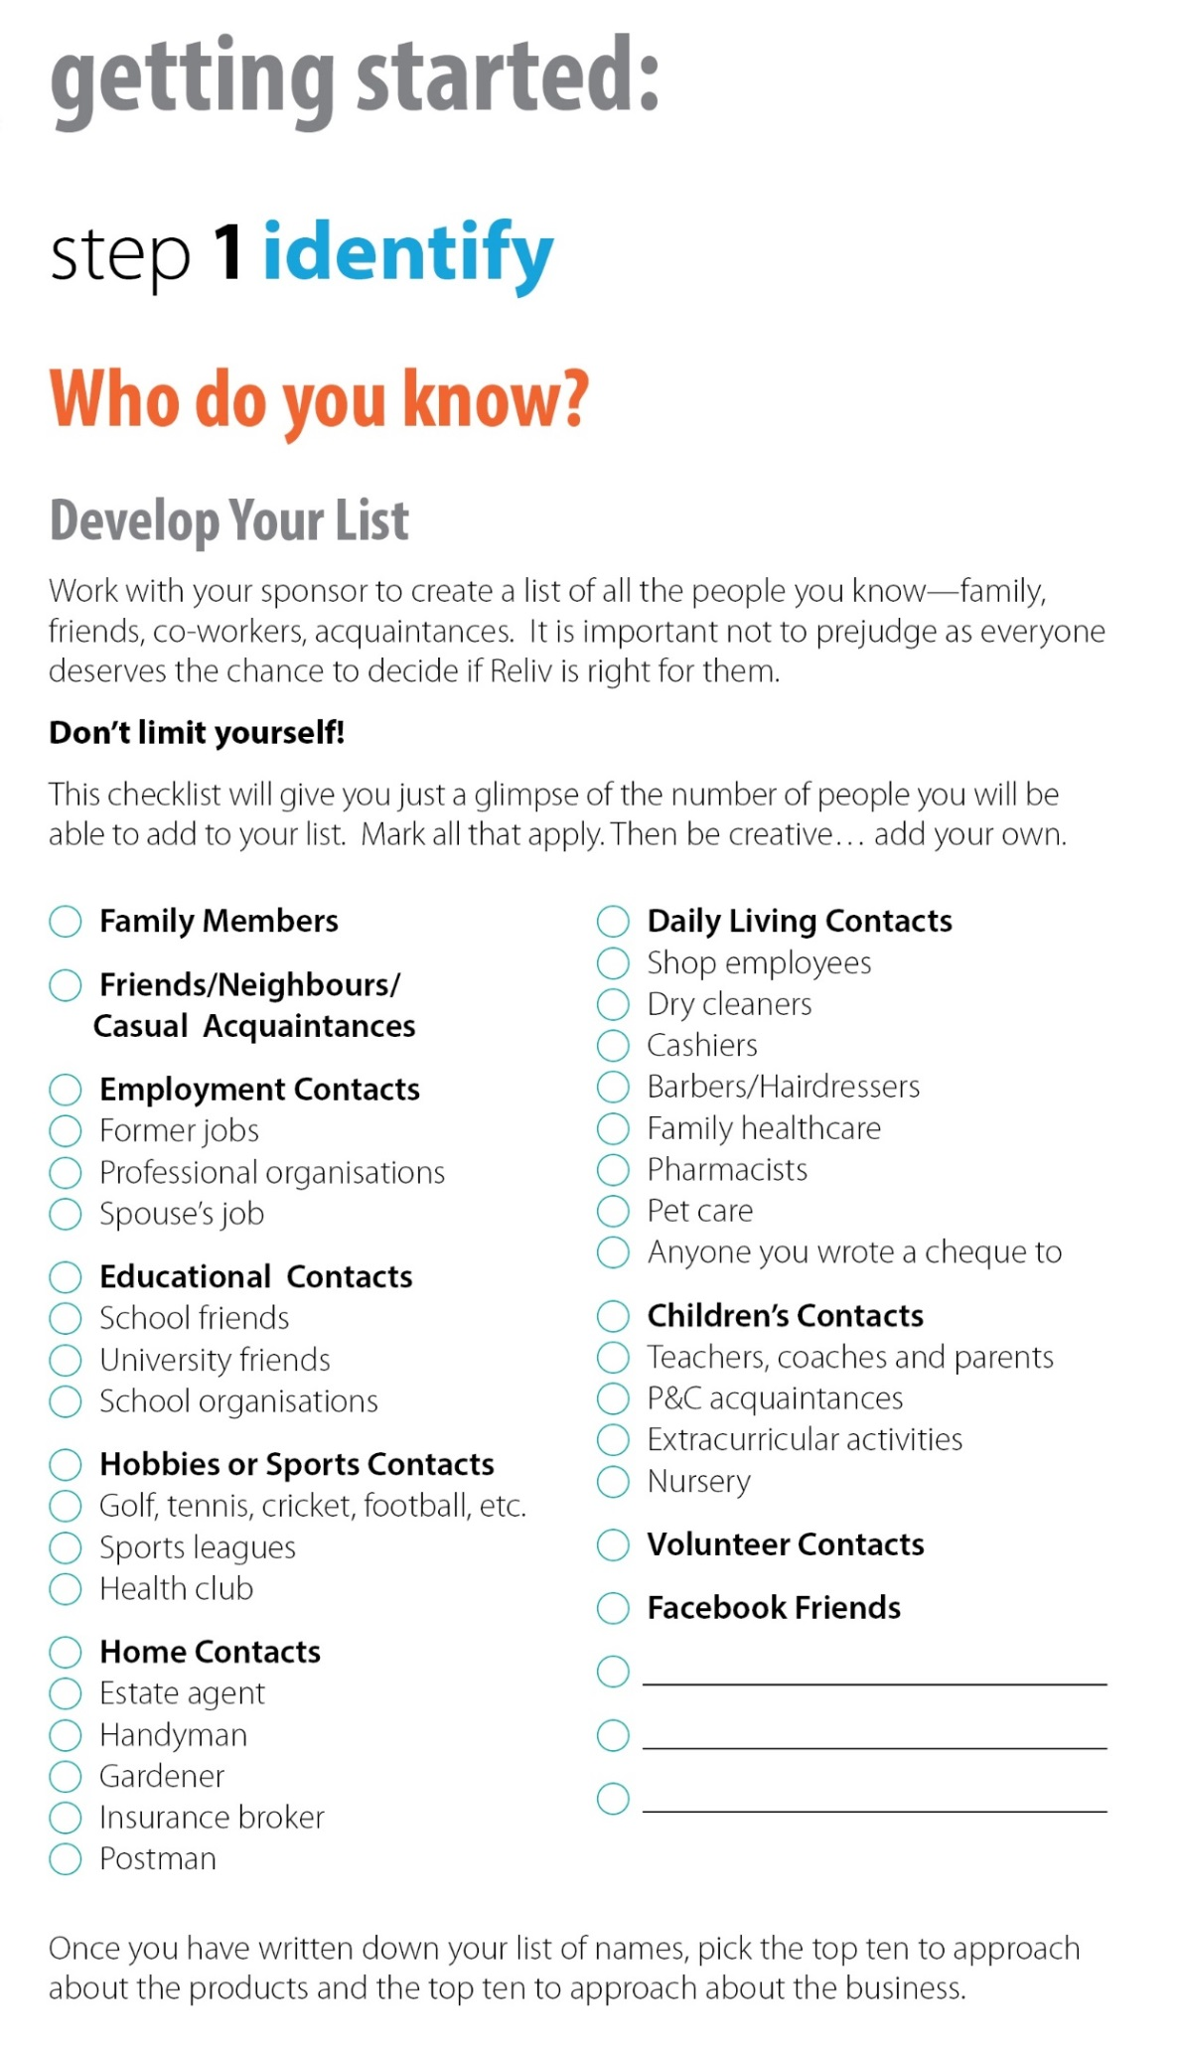

Notes:
This is from getting started guide and it shows the memory jogger of the number of different categories that you can find contacts in. You would be amazed at how many people you actually know.
Remember not to prejudge anybody and to speak to everybody remember our business is also about sharing story sharing your story and will come to that in another module of our training.

Slide 12


Identify
Your list is never complete
Go through
  Your phone list
  Your address book
  Your email address list
Notes:
It's important to understand that you list is never complete your list is never finished you need to go through your phone you'll be surprised only people are on your phone if you have a tablet and the sinking your have if you got a Hotmail account Gmail account you'll have contact after contact Dr contact because your email accounts record all of the people who you send emails to or received emails from to go through your address book you should make sure that every single avenue of potentially people to speak to you resource that define all people to add to your list.
The important thing to really take not here though is that you list is never complete and I know I've said that but you list is never complete no matter how many people you have on that list keep adding more

Slide 13
Identify
Ask for Referrals
Everyone you approach knows other people
If they are not interested
  ask them who they know who might be interested
  Remember, you are just Getting Started
Notes:
And here is one of the most significant things that you can do to be successful in your relive business. Ask for referrals!
So many people get timid or scared or worried about asking people for referrals but if you've been out there talking to people and people are trusting you you not try to sell the shoes off them then they will be willing to pass on a name to you from many many reasons. Particularly if you've spoken people before I'm not talking about the first time you speak to someone but if you speak to some of the first time and they say no you should always ask for a referral you should never walk away from anyone who's not going to either become a a customer of yours or distributor in your organisation should never walk away from anybody who is not granted achieve that without asking for a referral.
And all you need to do is say while we've been talking that you've thought of four or five people who would be interested even though you may not be I'm very happy to speak to these people if you be kind enough just to give me an introduction.
Remember that you are just getting started and the more referrals you get the longer your list gets and referrals are warm market because when you speak to somebody whether you have an introduction whether they just given you a number when you speak to someone who is a referral by starting it off by saying I was speaking to Tony and Tony suggested that I should talk to you immediately breaks down the first barrier with people so referrals are so important because it keeps you warm list growing.

Slide 14
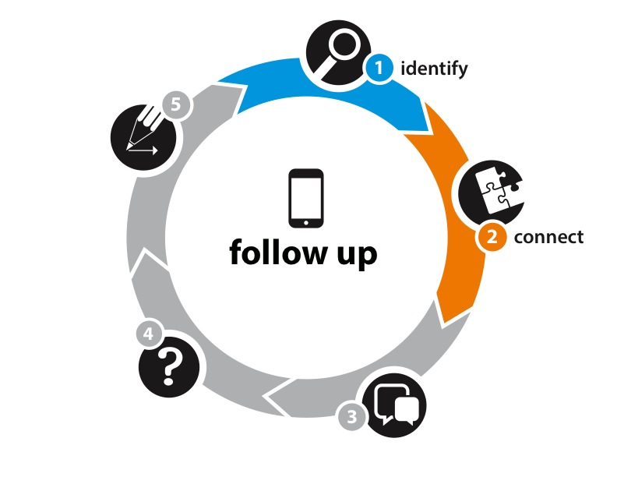
Connect
How do you connect with people?
  In person
  Online
  In print
Your business grows when you tell people about Reliv
Goal: Set an appointment
Notes:
So how do you connect with people well as you can see suggested this three different ways you can do it in person online and in print well obviously with your hot market and your warm market in person or by phone is going to be the most effective way for first contact. Of course you might find that messaging or using one of the messaging apps available today Skype depending on where they are based I'm Viber there are so many different ways that you can communicate with people now by utilising technology that's available and remember that the goal is to set an appointment.
The best way for your business to grow is by telling lots of people about it consistently everyday

Slide 15

Connect – in person
You are the biggest asset in building your business
  Reach out
  Ask
  Listen
Your business grows when
you share your story
Goal: Set an appointment
Notes:
As it says here you are the biggest asset in building your business so simply reach out to people open your mouth say hello start a conversation and share your story ask people questions ask them how they feel remember the old acronym F0RM - form. Family occupation recreation money you will always find in at least one of these areas that someone has an issue or a problem or a challenge.
And once you get people talking and lace and believe me if you can get people talking about one of these things that the passion about whether have an issue you won't have to prompt and do much sulky talking all you need to do is listen. When you hear what they say then you can relate a story be your story or someone else's story that you know to them so that you can achieve your goal which is to set an appointment.

Slide 16

Connect – online
Use Reliv’s Social Media platforms to connect
  Share:
    Videos
    Stories
    Marketing tools
  Email & Facebook links
  Utilise the Mobile App – podcasts, videos
Your business grows when you share results
Goal: Set an appointment
Notes:
In this day and age there are so many other ways that you can connect with people. Online can be a tool used properly can be effective for you. You can use relive social media platforms to connect we have Facebook we have Twitter we have Pinterest can drive people towards those media platforms if that's what you choose we have things that you can share we have videos we have stories in pod casts on the mobile app on our training page you can send an email to someone with a link to a video or a story which is in pod casts form which is an audio file.
So use the tools use the marketing tools provided if you going by email send the link in the emails of the bed and click on it go straight to it and listen to it utilising the mobile app pod casts in the videos is right there in the palm of your hand and you can download your favourite one is to keep on your phone or on your tablet or iPad tablet is that you have.
Remembering that your business grows when you share results and to keep focused on your goal which has reset on each slide set an appointment don't get caught out trying to close people to quickly it's all about setting an appointment when you connecting whatcha doing here is your connecting with people it's about setting an appointment.

Slide 17

Connect – in print
LunaRich makes Reliv the
Nutritional Epigenetics Company
  Product Catalogue
  Online brochures
Your business grows when
you share information
Goal: Set an appointment
Notes:
Connecting in print is not used as much these days because of technology but we have the product catalogues we have on my brooches that you can download and print off we have getting started guide and we have the presentation which is also available online because your business grows when you share information. And again I emphasise that you've goal at this stage is to set an appointment talk about the opportunity in particular if it's the product you very well may eight may be able to go ahead close someone Solomon product but is far better to be face-to-face when you actually take people to the next level whether that be face-to-face in a coffee shop in their home or maybe even on a Skype call on a video call but we can see each other

Slide 18

2. Connect
Review 20 prospects with upline —
Who’s first?
What do I say?
  Share excitement and why you thought of them!
  Using their why lets them know you care
Use company tools to validate
Goal: Set an appointment
Notes:
So now that we've covered identifying people your next going to connect and the question that everyone asks years what am I going to say? So think about it why did you write them down that's why you write down the reason put them on the list because that's what you're going to share with them.
And you need to hear about this. You're excited about it doesn't have to be perfect it doesn't have to be scripted, you just have to let them know that you're excited about them getting the chance to learn about reliv
Sometimes it comes down to why you got involved with relive in the first place. If you got involved because of the business show them that, just start telling them that something you're excited about that other companies don't have, this company I'm with really going to go places and I think it would really enjoy taking a look at this.
Through this training you're going to learn about the tools available to you from relive. You going to get some suggestions about what you might want to say to people when you meet them. Use these companies tools to validate what you're talking about you have the best tool for you to use is the mobile app. This gives you access to testimonials pod casts videos being able to purchase right there and then to sign people up by and then this is the best tool for you to use a remember the goal when your first connect with people is to set an appointment. Very important that you do not forget that is your goal

Slide 19

Connect
Set up an appointment
What do I do?
  Set up a time and place
  Include your upline (if available)
  Do not go into detail
  Answer all questions at the appointment
Your upline will do this 3 or 4 times –
then it’s up to you
Goal: Set an appointment
Notes:
Okay so now we've reached the point where you set up an appointment so what do you do well of us are you need to set a time and a place and you need in the early days that you use your up line make sure that your sponsor is available get times from your sponsor previously you have an idea of when you can set time. Remember it so important when you're setting appointment is to not go into detail.
People will obviously ask questions and the answer you need to give is that is a very good question and add to that for you when we meet. If they keep pressing just say I understand but right now I don't have the time to go into it and I wouldn't be able to justify the question by giving a good enough answer. So I will and all of your questions when we meet.
The objective is to have your up line with you three or four times a you can learn what to do and then you do it yourself if you're the up line you go with your new person and show them what to do for you set them loose because the whole concept is to make sure that people are trained they know what to say and are comfortable in the situation okay that important and again goal is to set an appointment

Slide 20
Opening Sentences
How are you? – just ask and listen
Kathy, I know your health is a priority. I’m working with a company that could really help you. When can we get together?
Hi, John. At the soccer game you mentioned that finances are tight. You need to hear about something that has helped me. When can we get together?
I’ve just started in something that made me think of you. You really need to check this out — it’s a chance to earn some serious money. When can we get together?
Use tools & stories to validate
Goal: Set an appointment
Notes:
So you might wonder what it is you going to say, try “how are you” to begin with. Just listen, they will share with you what is happening and then often they will say and how are you today you just have to come back and say I'm doing incredibly now that I've gotten onto these amazing products of got my health back on track and with everything else that I'm doing with this it's helped me financially as well as on building a business around Australia.
Just ask and listen the best thing you can do is ask open-ended question. An open-ended question is a question whether the answer is not yes or no but the answer is descriptive and therefore they need to speak and by asking open-ended questions and prompting people it gets them to talk if your listening you will hear everything that you need to hear. Remember the old saying we have two ears and one mouth so we should listen twice as much as we talk
We got some sample opening sentences here Cathy I know you health as a priority on working with a company that could really help you when can we get together.
Is always a good idea to give people an option when to get together so you might say something like hi John the soccer game you mentioned that finances are tight and you wouldn't mind doing something to alleviate that while you need to hear about something that's help me and my family considerably when can we get together would you be available Tuesday or Thursday?
And another one, I just started in something that made me think of you. You really need to check this out – it’s a chance to earn some serious money when can we get together tomorrow or the day after.
Remember again using the tools and the stories to validate the goal as a set the appointments and do not answer all of their questions at this point that is not the objective the objective is to set appointments so can get down and really do with what needs to be dealt with get these people on board either as a customer or as a distributor in your organisation.

Slide 21

Connect
Nothing happens
in your business
Until Someone
talks to Someone,
Somewhere
Notes:
And at this says here nothing happens in your business until someone talk to someone somewhere.
So you be the someone and you find the other someone and you do it everywhere everywhere you are a matter where you are a matter when it is a new start by connecting with people by very simply starting up a conversation. That is how your business starts to grow.

Slide 22
Duplicate, Duplicate,
Duplicate…
Who’s Next?

Slide 23

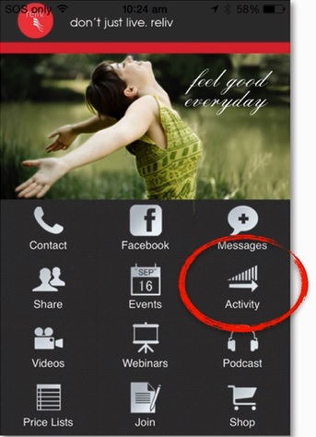
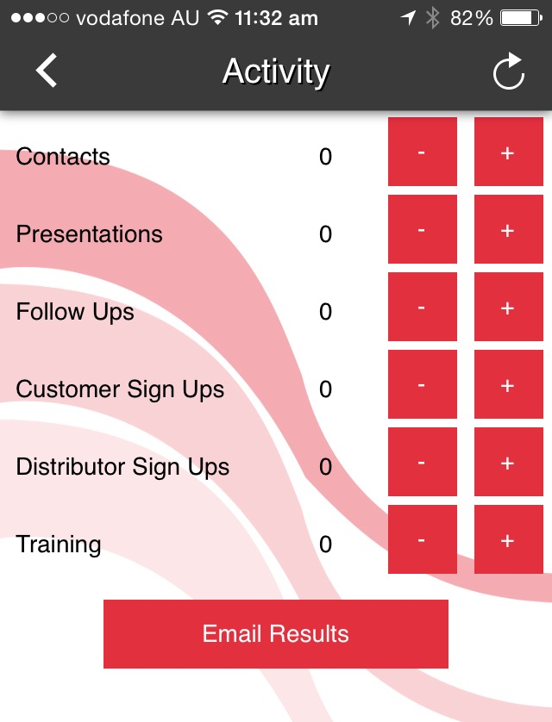
Set Your Goals – NOW!
Notes:
On this slide your cover of any upcoming events in your area

Slide 24

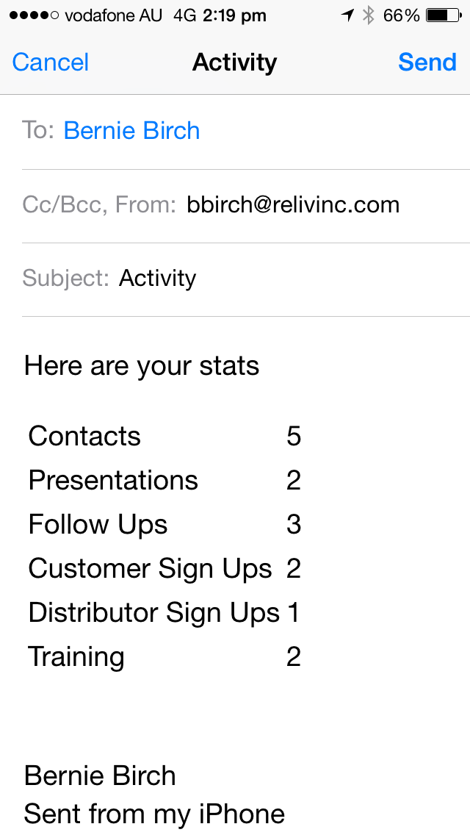
Send Your Upline a Copy

Slide 25


Upcoming Events
Notes:
On this slide your cover of any upcoming events in your area

Slide 26
Business Success Training
Module 1
Notes:
Announce that this is Module 1 of the Reliv Business Success Training program which will last for approx. 2 hours with a 10 minute break in the middle
Say what I'm going to do today share with you some of the foundational success steps that distributors have used to build successful Reliv businesses.
Congratulate everyone for being there, on making the decision to join Reliv (if new people in the room), and investing in your business today.
Share the Reliv story – to ensure everyone knows it and has the confidence to share it by regularly hearing it, in a nutshell (this can be as short or detailed as we determine):
Reputable company been in business for 27 years.
Founded on a product and a mission to nourish our world
Creator spent 10 years researching and developing the first nutritional formula, still the basis for our number one selling product today.
Retired businessman Bob Montgomery met Dr Kalogris at a health show, he was interested in the science behind the formula – potency, synergy, bioavailability - and he and his family had great health results from the product.
Dr Kalogris was a scientist he didn’t know how to market the product and after his own great results Bob Montgomery knew this was something special.
Bob understood the power of personal recommendation and decided the best way to market this product was through Direct Selling, which also gave people who may not have the money to start a business or franchise, the opportunity to start their own Direct Selling business for a very low start-up and unlimited income potential.
Renowned food scientist Dr Carl Hastings joined forces and Reliv was born.
Today we are fulfilling the mission of nourishing our world by helping people with their health, their finances and we are currently feeding over 40,000 people daily, mostly children, through our charity, the Reliv Kalogris Foundation.
This is a company to be proud of, a company with nutritional products and a business opportunity you need to share with everyone you know and today we’ll teach you how.
Move to next slide

Slide 27
Notes:
This slide is up whilst people are arriving and music is playing.
When you start welcome everyone and ask them to switch off their mobile phones or switch them to silent if they need to leave them on for any reason
Advise of any housekeeping issues like where the toilets are, etc
Move to next slide immediately after this

